Slide 1
Time Optimal Gathering of Myopic Robots on an Infinite Triangular Grid
Pritam Goswami, Avisek Sharma, Satakshi Ghosh & Buddhadeb Sau
Jadavpur University, Kolkata
SSS,2022

Slide 2
Outline
Introduction
Problem Definition and Model
Our Contribution
Outline of the Algorithm
Conclusion and Future Works

Slide 3
Introduction
Robot Swarm: A collection of small autonomous inexpensive robots working cooperatively.
Application: Surveillance, Cleaning large surface, Moving objects etc.
Objective: Identifying minimal capabilities of the robots in the swarm to do a specific task.
Tasks: Arbitrary Pattern Formation, Gathering, Dispersion etc.

Slide 4
Introduction
Gathering: All deployed robots on a terrain moves to a single point.

Slide 5
Introduction
Considering Tessellation graphs,
In [CDDN21]¹, authors have provided an algorithm for arbitrary pattern formation that allows multiplicity points in target configuration.
So this algorithm is capable of gathering on an infinite triangular grid.
Limitation
Algorithm is not valid for myopic robots

Slide 6
Introduction
So we have this question,
Can we design an algorithm for gathering with myopic robots on an infinite triangular grid?
If yes then,
What is the minimal capabilities each robot shall have to solve it?

Slide 7
Introduction
Infinite Triangular grid
A graph G = (V, E)
V={vertices of the triangle}
E= {(v1,v2): d(v₁,v₂)=1}

Slide 8
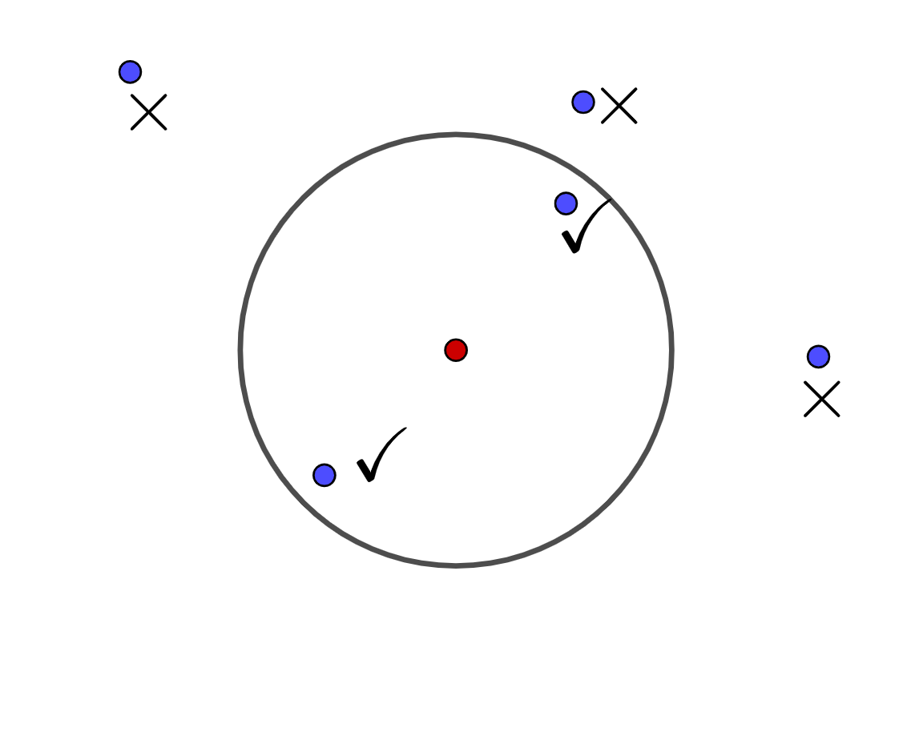
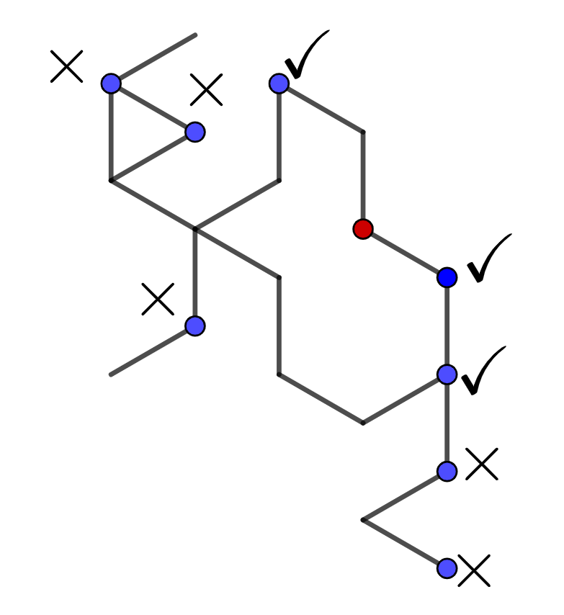
Introduction
Myopic Robots: Robots that can only view up to a finite region.

Slide 9
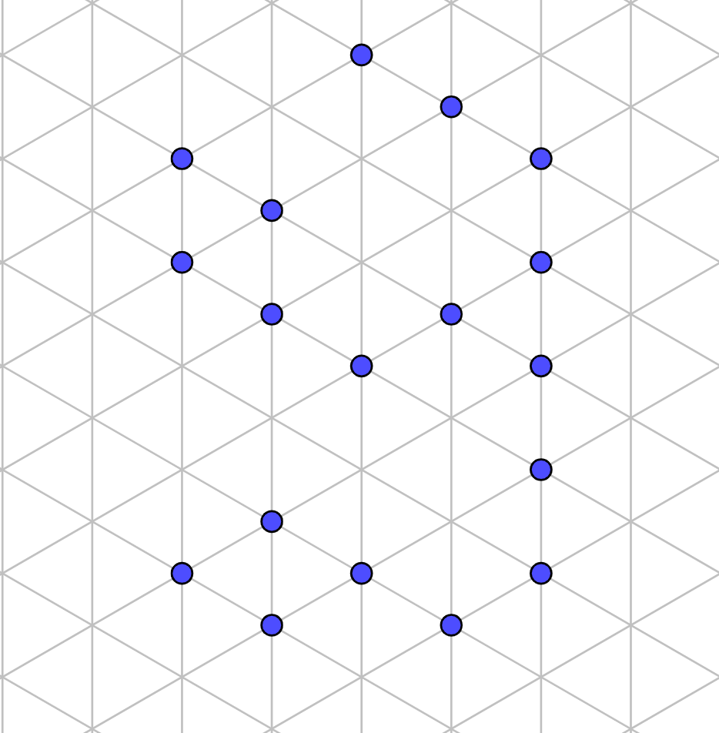
Problem Definition
n Robots on vertices of an infinite triangular grid.
k-Hop Vision.
visibility graph connected.
Algorithm A

Slide 10
Model
What are the minimal capabilities each robot should have to solve this problem ?

Slide 11
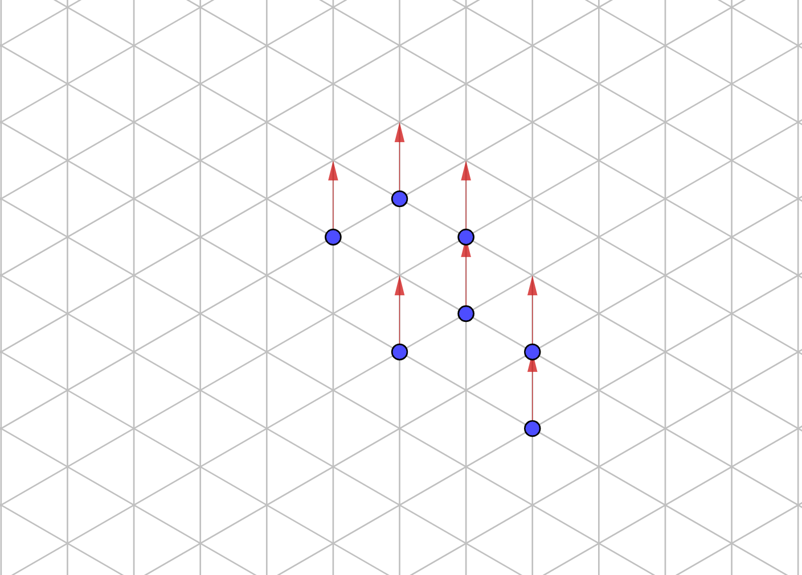
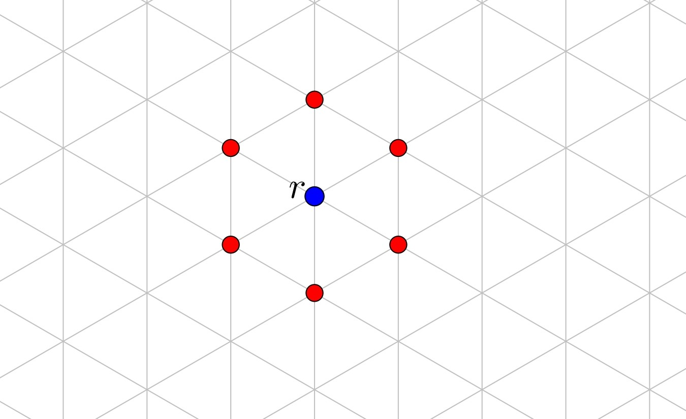
Model
Autonomous
Anonymous
Homogeneous
Identical
Oblivious
Silent
Autonomous No central Control.
Anonymous The robots have no unique identifiers.
Homogeneous All robots run the same distributed algorithm.
Identical The robots are physically indistinguishable.
Oblivious The robot have no persistent memory to remember previous steps.
Silent The robots have no means of communication between themselves
OBLOT
Dimensionless
The robots are points.
1-hop Visibility
One-axis
Agreement
Sees neighboring vertices only.
Agree on
direction of any one line that generates the triangular grid
an orientation along it.
considers it as direction of positive Y-axis.

Slide 12
Model: Robot
The robots operate in a Look-Compute-Move (LCM) cycle
Executes a distributed algorithm with information from look phase as input and gets location of a destination as output
Gets location of all robots it sees as input
Destination
Look Phase
Compute Phase
Move Phase

Slide 13
Model: Scheduler
Semi-Synchronous (SSYNC) Scheduler
Time is divided into rounds of equal lengths.
In the beginning of each round a subset of robots get activated and perform LCM cycle synchronously.
Idle
Activated
Activated
Activated
Idle
Fig: Only the activated robots perform LCM in a given round. They Look together, Compute together and Move together.

Slide 14
Our Contribution
We have two contributions
One-Axis Agreement: Necessary and sufficient to gather point robots with
OBLOT model
1- hop visibility
on an infinite triangular grid under semi synchronous scheduler.
Time Optimal Algorithm: Algorithm 1-Hop 1-Axis Gather (provided for sufficiency part) is time optimal

Slide 15
Comparison with Previous Works
SL No | Algorithm | Terrain | Axis Agreement | Visibility | Final Gathering Configuration
1 | Algorithm in [CFSN21]¹ | Regular Infinite Triangular Grid | None | Non- Restricted | Ideal
2 | Algorithm in [FPSW05]² | Euclidean Plane | Two axis | $$V( >0) ∈ ℝ$$ | Ideal
3 | First Algorithm in [PS21]³ | Infinite Grid | Two axis | 2-hop | Ideal
4 | Second Algorithm in [PS21]³ | Infinite Grid | One axis | 3-hop | Relaxed
5 | 1-Hop 1-Axis Gather | Regular Infinite Triangular Grid | One axis | 1-hop | Ideal

Slide 16
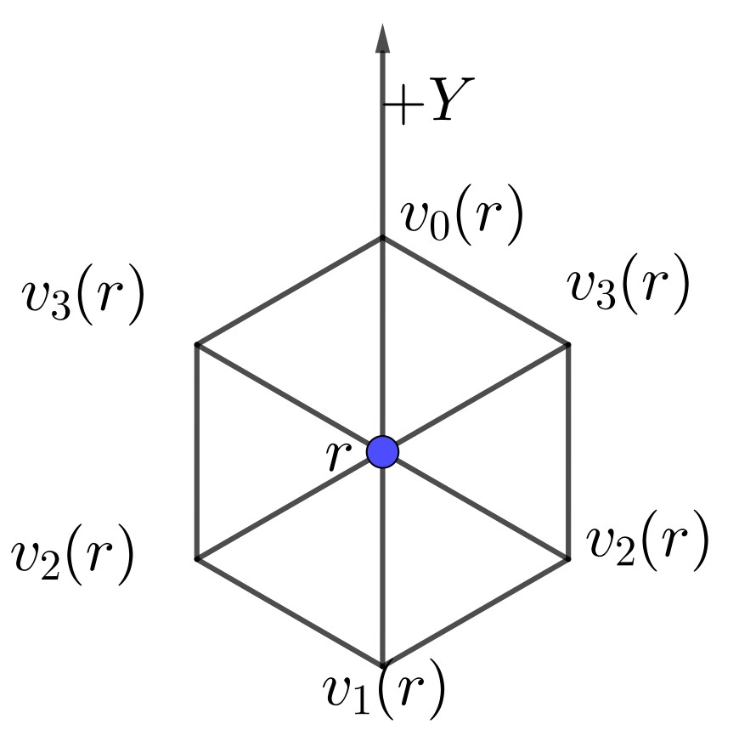
Outline of the Algorithm: Preliminaries
Robot r sees 6 vertices with 4 different Y-coordinate values of -1, -0.5, 0.5 and 1.

Slide 17
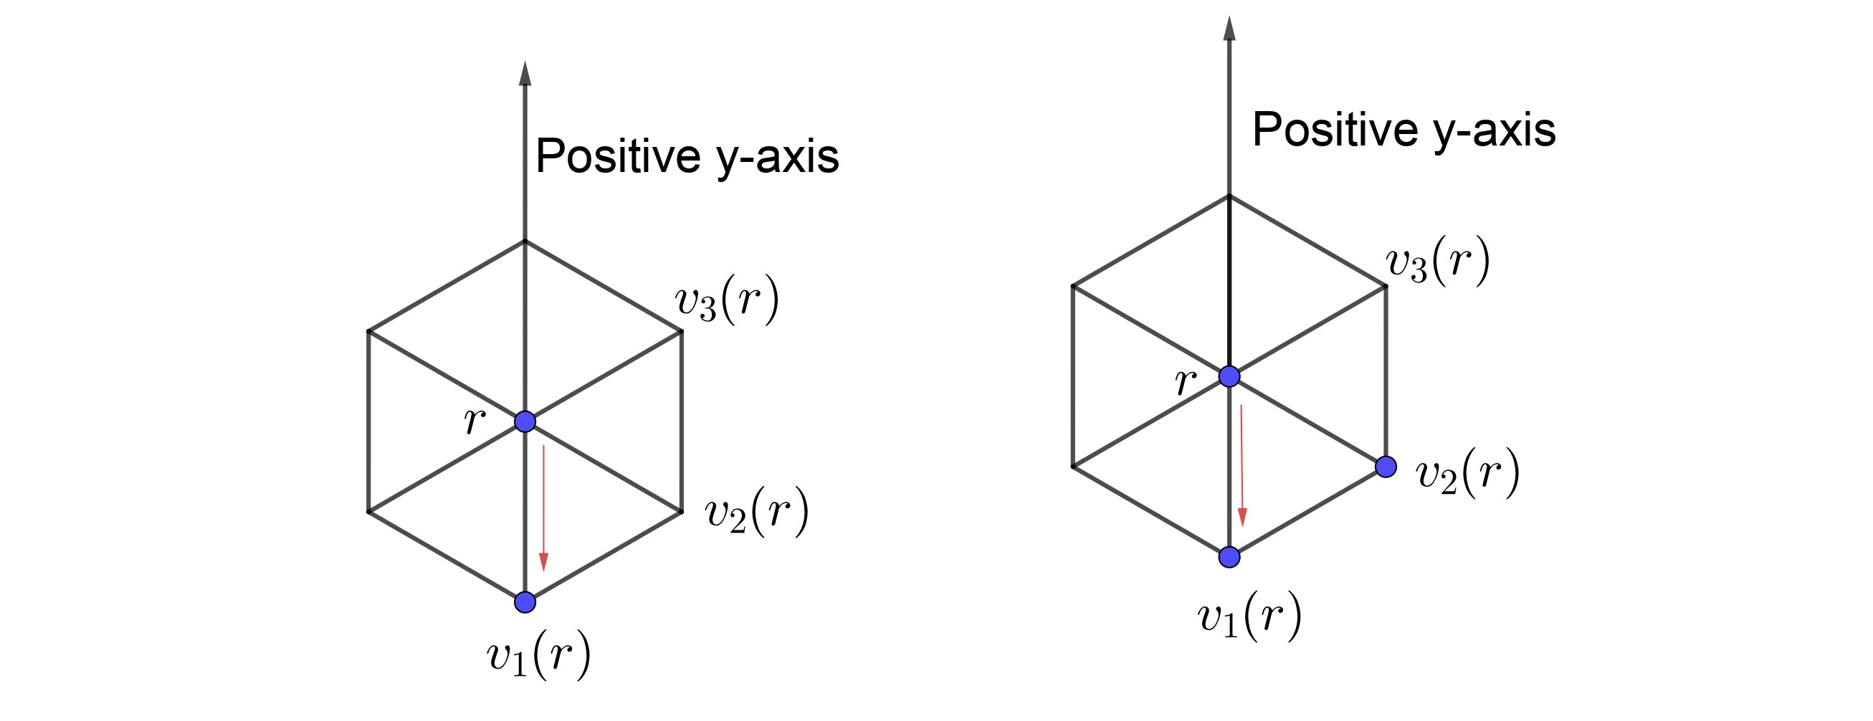
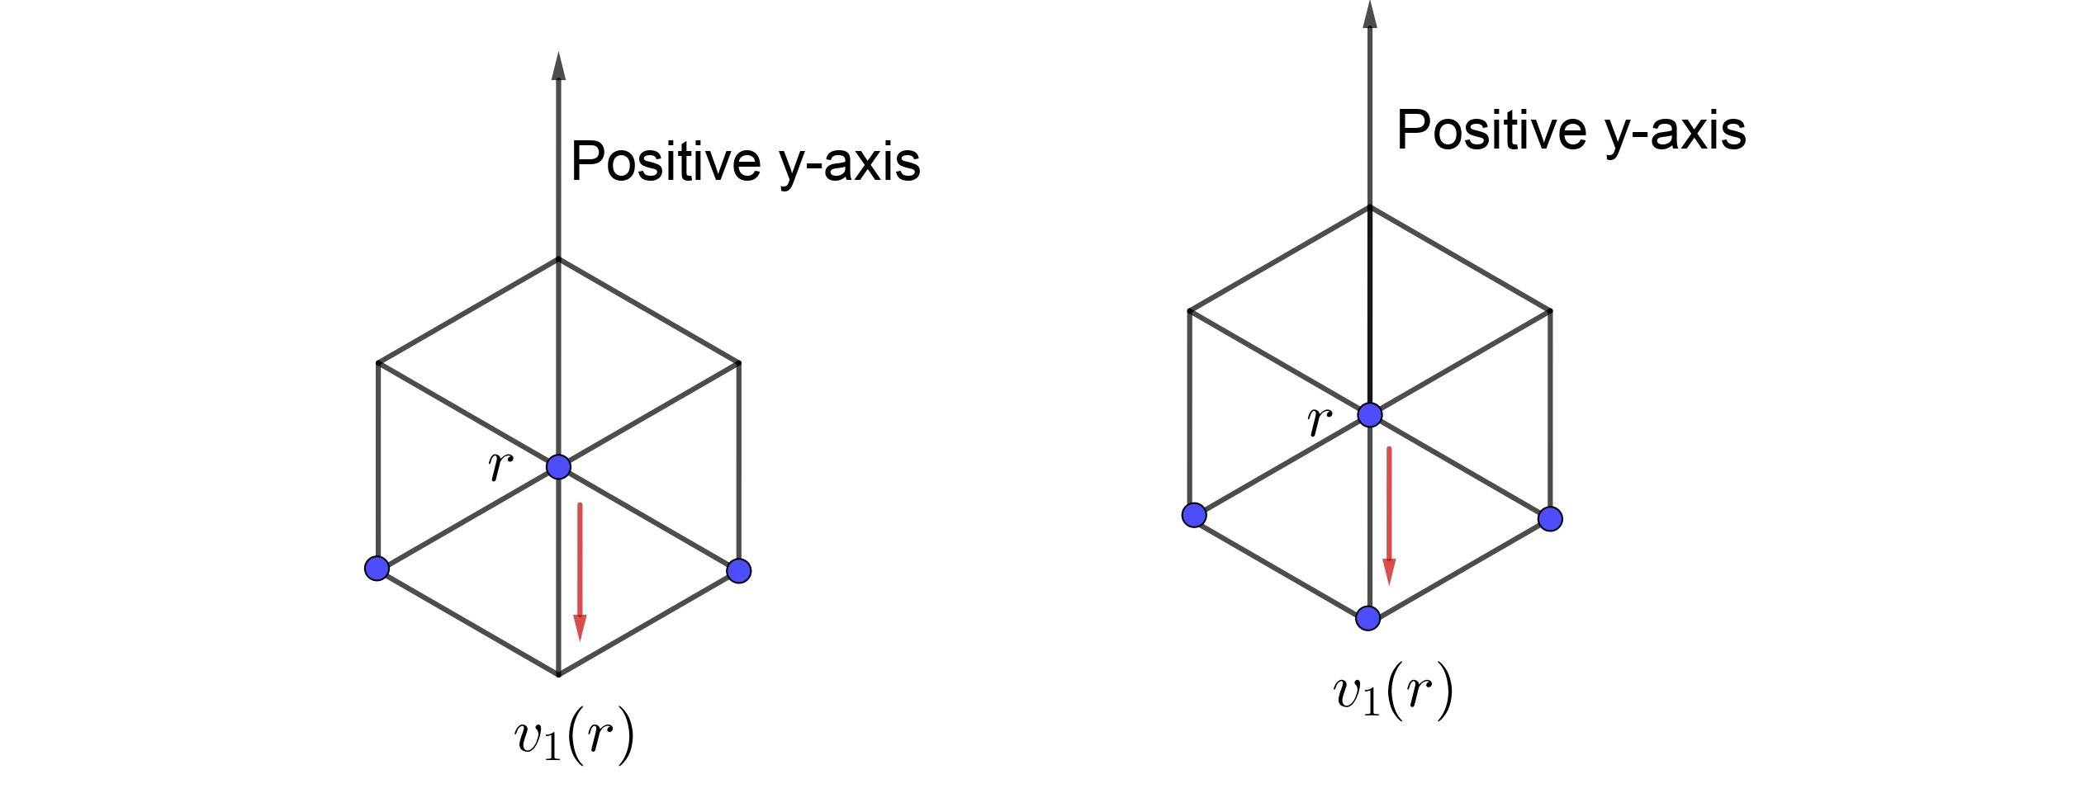
Outline of the Algorithm

Slide 18
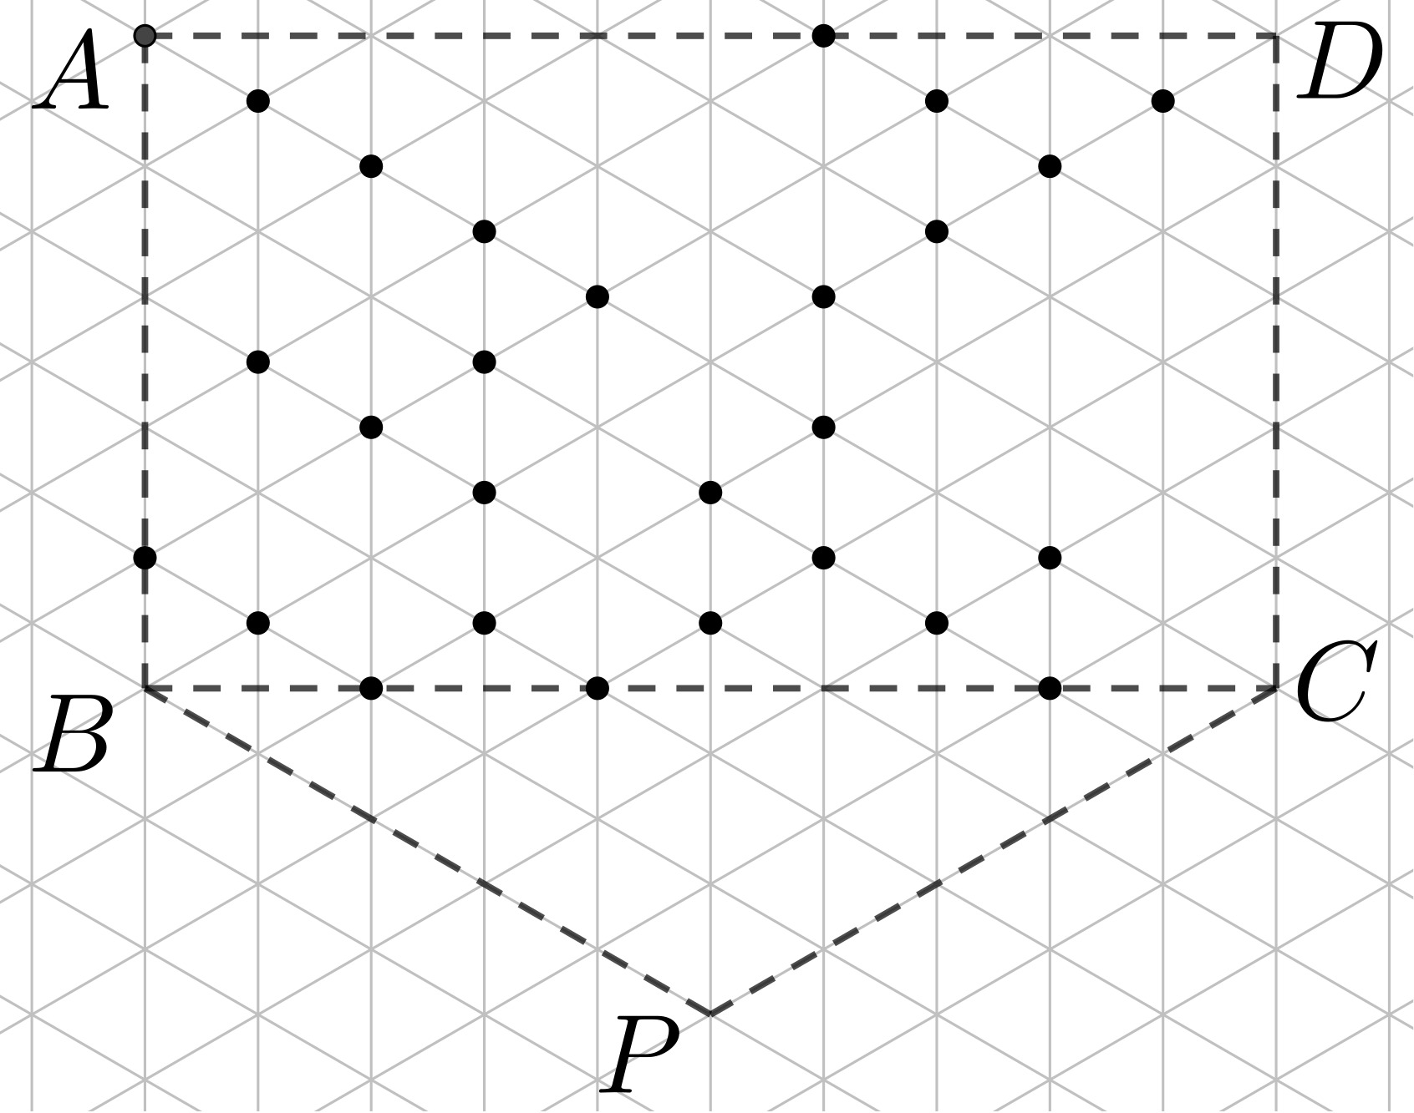
Outline of Correctness
Lemma 1 Visibility graph remains connected.
Lemma 2 Top layer shifts down always in one epoch.
Lemma 3 No robot ever goes out of the bounding polygon.
If already not gathered,
By Lemma 2: in 2(length of AB+ Height of Δ CBP) epoch top layer contains single vertex (i.e, P).
By Lemma 3: all robots must be on P

Slide 19
Outline of Correctness
Theorem 1
Algorithm 1-Hop 1-Axis Gather guarantees that there exists a round t>0 such that a swarm of n myopic robots on an infinite triangular grid G with 1-hop visibility and one axis agreement will always gather after completion of round t under semi-synchronous scheduler starting from any initial configuration for which visibility graph G_{c} is connected.
Theorem 2
The algorithm 1-hop 1-axis Gather takes at most O(n) epochs to gather all the robots.
Theorem 3
Any gathering algorithm on a triangular grid takes Ω(n) epoch.

Slide 20
Conclusion and Future Works
In Conclusion,
One-axis agreement is necessary an sufficient for gathering OBLOT point robots having 1-Hop vision on an infinite triangular grid.
Algorithm designed to show the sufficiency part is time optimal.
For future course of research,
Considering Asynchronous Scheduler.
Designing a collision less gathering algorithm (i.e, Collision is accepted only at the gathering vertex) with k-hop vision (k>1).
Finding if some class of configuration exists for which axis agreement may not be necessary.

Slide 21
Thank You

